Slide 1
Microclimates

Slide 2
How do climates vary within small spaces and how are these microclimates affected by climate change?
Learning objectives
Small-scale climate variations
Factors that create microclimates
How do microclimates affect humans?
How are microclimates affected by climate change?
To answer these questions, we will:
Learn the difference between climates and microclimates
Explore how various factors, such as refection, energy trapping, and land cover, can affect the temperature of microclimates
Discover how humans are differently affected by microclimates
Investigate how microclimates will be affected by climate change

Slide 3
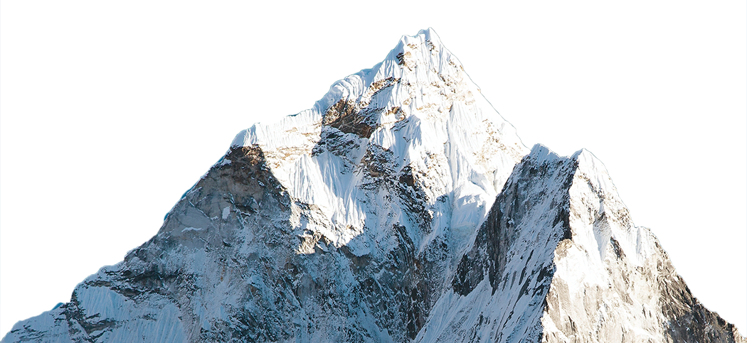
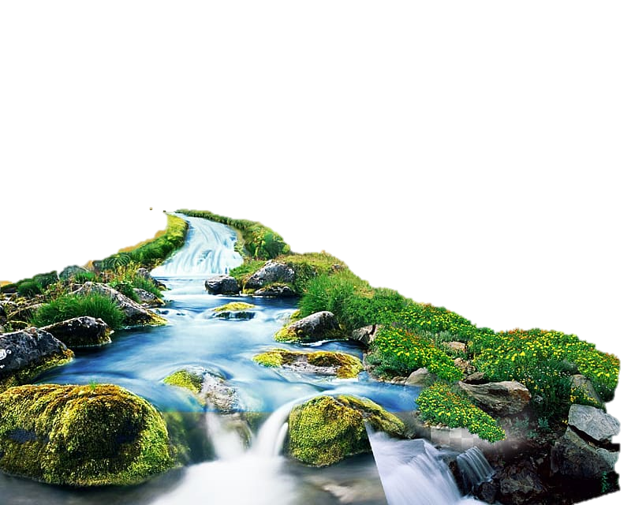
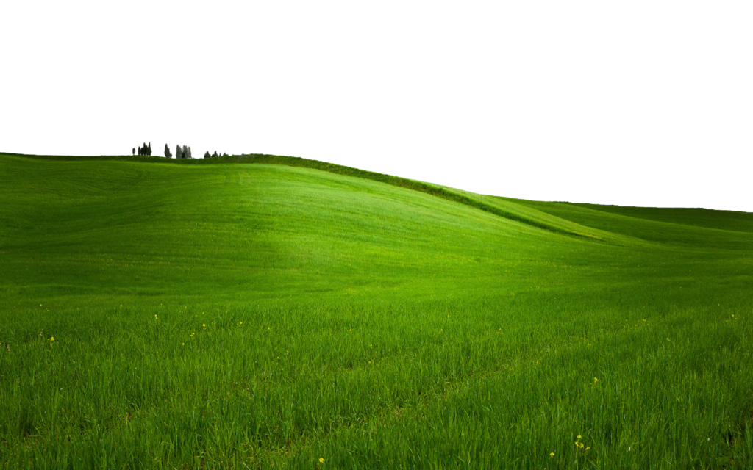
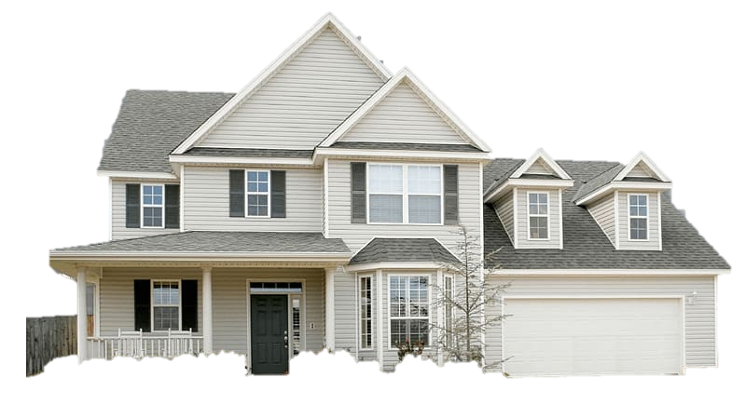
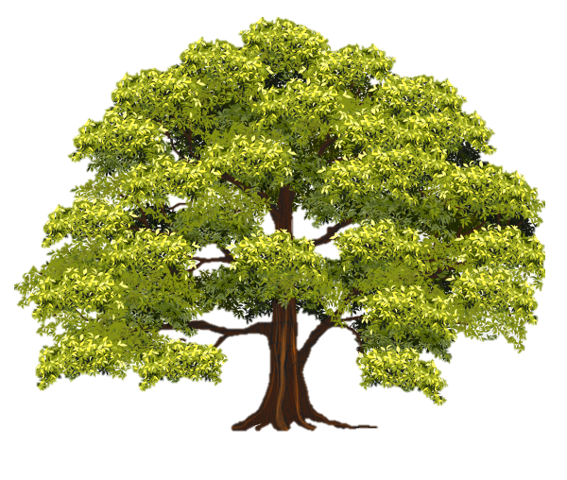
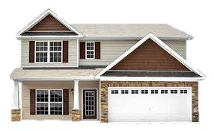
Small-scale climate variations
Learning objectives
Small-scale climate variations
Factors that create microclimates
How do microclimates affect humans?
How are microclimates affected by climate change?
Microclimates – a small area where climate differs from the overall regional climate
Affected by landcover, population and building density, water, and other factors that vary across space
Rural areas tend to be cooler than urban
Notes:
While we know that climate can vary by region, altitude, and latitude, climate can also vary in smaller spaces. When a small location, whether it be the other side of the street or between rural and urban areas, has a climate that varies from the general climate of the area, these are called microclimates.
Microclimates are cooled and warmed by a variety of factors, including landcover, population and building density, waterways, vegetation, and pollution.
In general, rural areas tend to be cooler than urban areas.

Slide 4
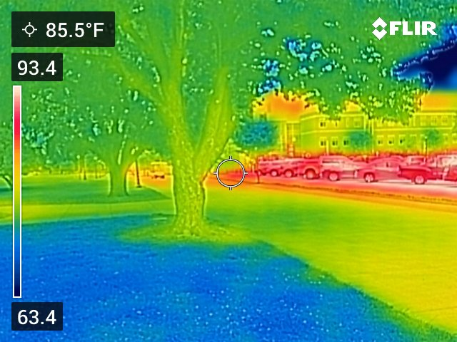
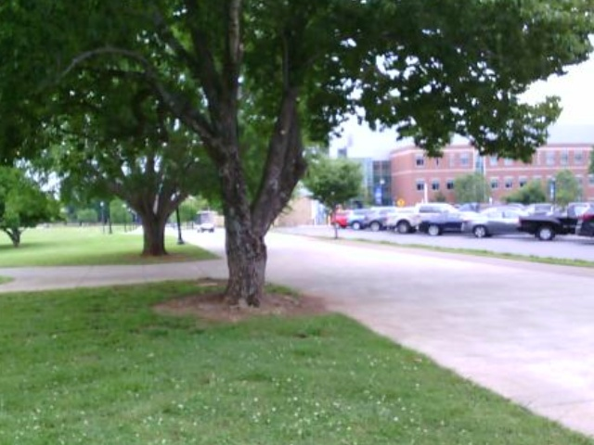
One cloudy day in May…
Learning objectives
Small-scale climate variations
Factors that create microclimates
How do microclimates affect humans?
How are microclimates affected by climate change?
86°F
80°F
78°F
Notes:
On any given day, we walk through and experience microclimates. For instance, the location in these images is on the Middle Tennessee State University campus on a cloudy day in May.
The photo on the left is a thermal image – the temperatures shown are surface temperatures. Under the tree, it is significantly cooler than in the parking lot.
The photo on the right is the actual image and shows air temperature in this same area. Again, the air under the tree is much cooler than the air in the parking lot near cars.

Slide 5
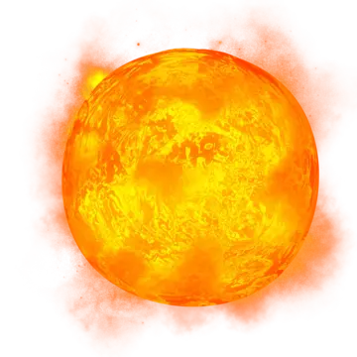
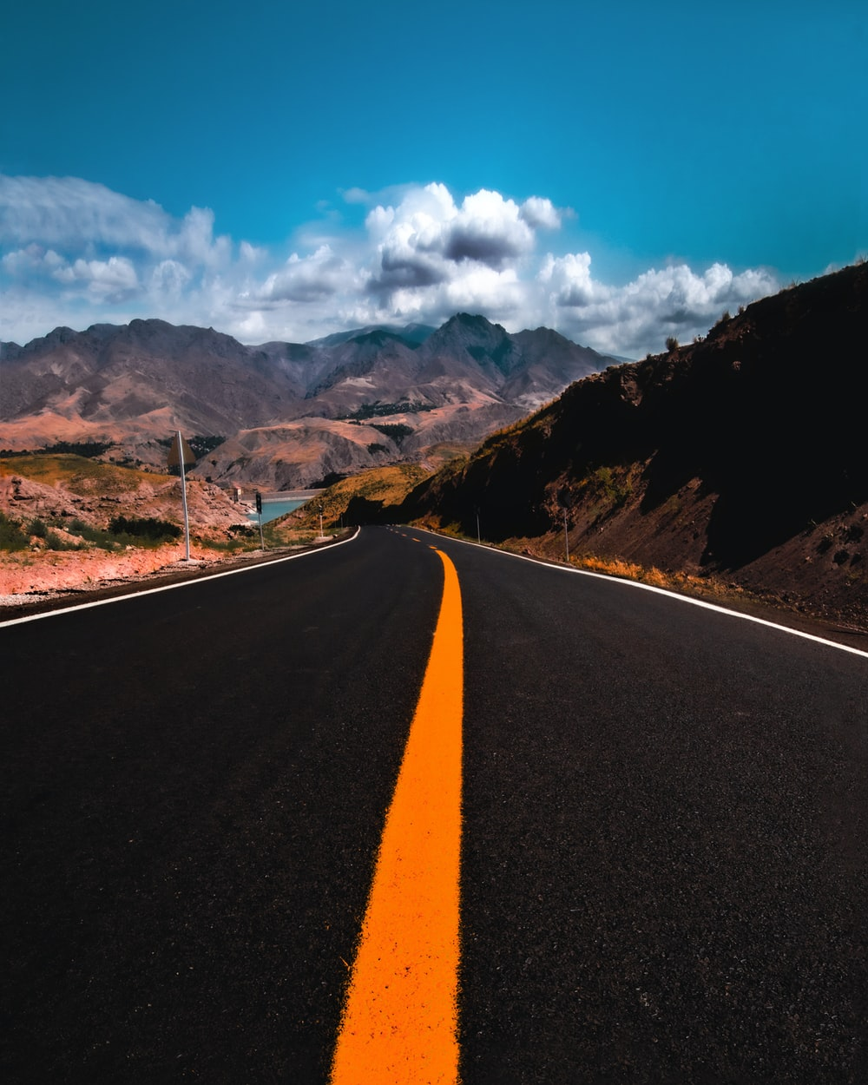
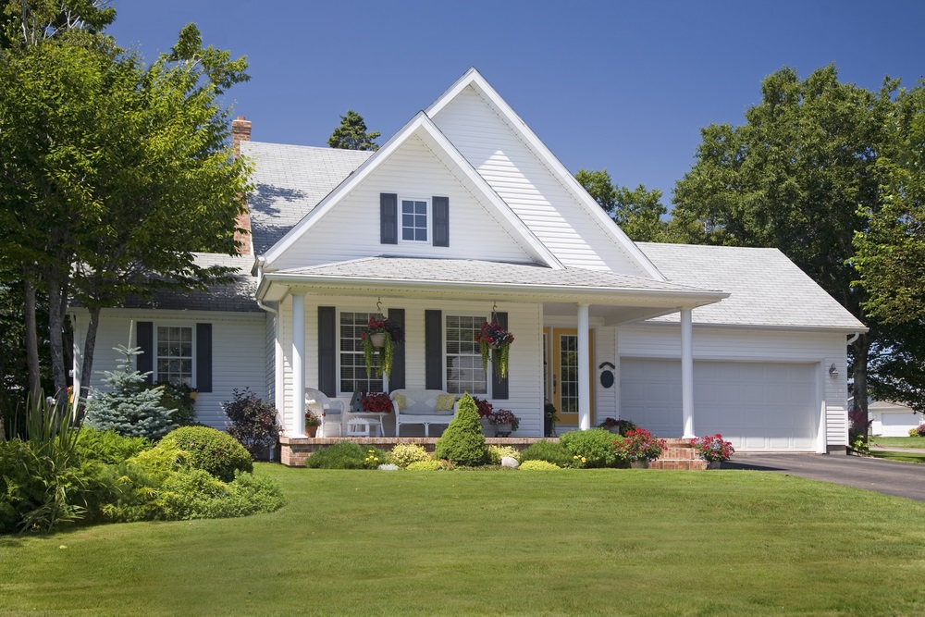
Creating Microclimates
Learning objectives
Small-scale climate variations
Factors that create microclimates
How do microclimates affect humans?
How are microclimates affected by climate change?
Albedo
Reflective property of a surface
Light colors, metal, and glass reflect insolation and are typically cooler
Dark colors and materials absorb heat and are warmer
vs
Notes:
On a warm, sunny day, would you want to walk on the dark pavement or the grass? Likely the grass. The blacktop is absorbing heat and slowly releasing it so it will feel hotter. The white house is reflecting heat, helping to keep this area cooler.
How much insolation or energy that a surface reflects is called albedo. High albedo surfaces, such as the white house, reflect much of the insolation that it comes into contact with.

Slide 6
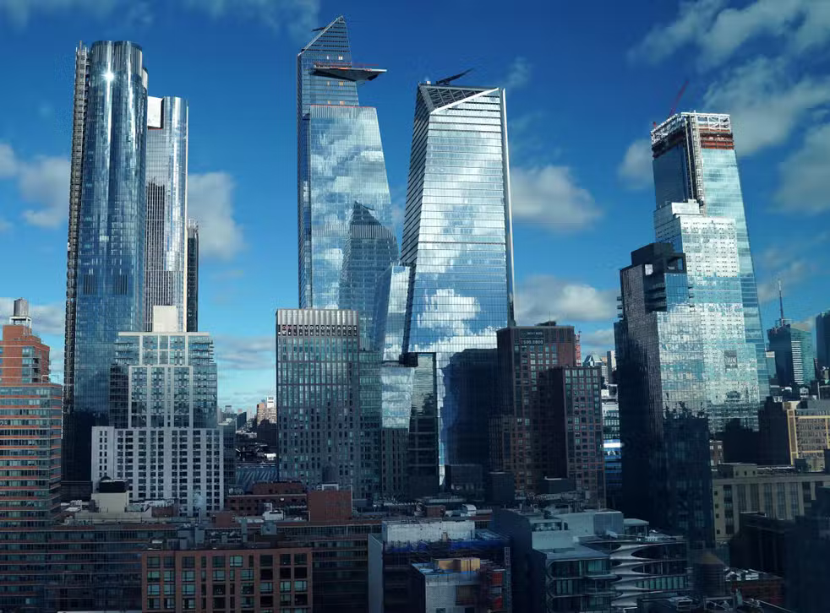
Creating Microclimates
Learning objectives
Small-scale climate variations
Factors that create microclimates
How do microclimates affect humans?
How are microclimates affected by climate change?
Energy Trapping
Despite reflective surfaces, energy can be trapped in urban canyons
Notes:
In areas that we have highly reflective surfaces, such as these skyscrapers made of glass, energy can be trapped between buildings (urban canyons), creating very warm conditions at the surface.

Slide 7
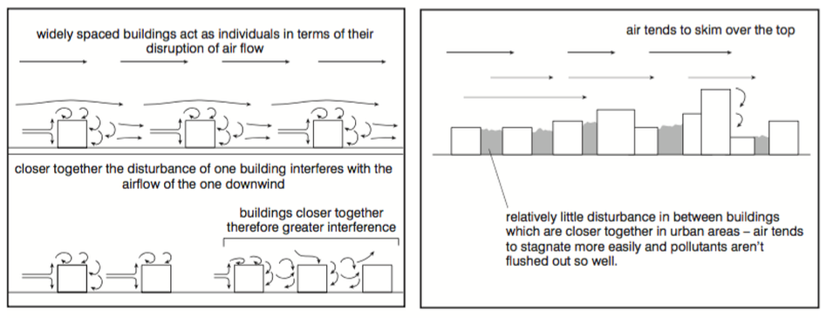
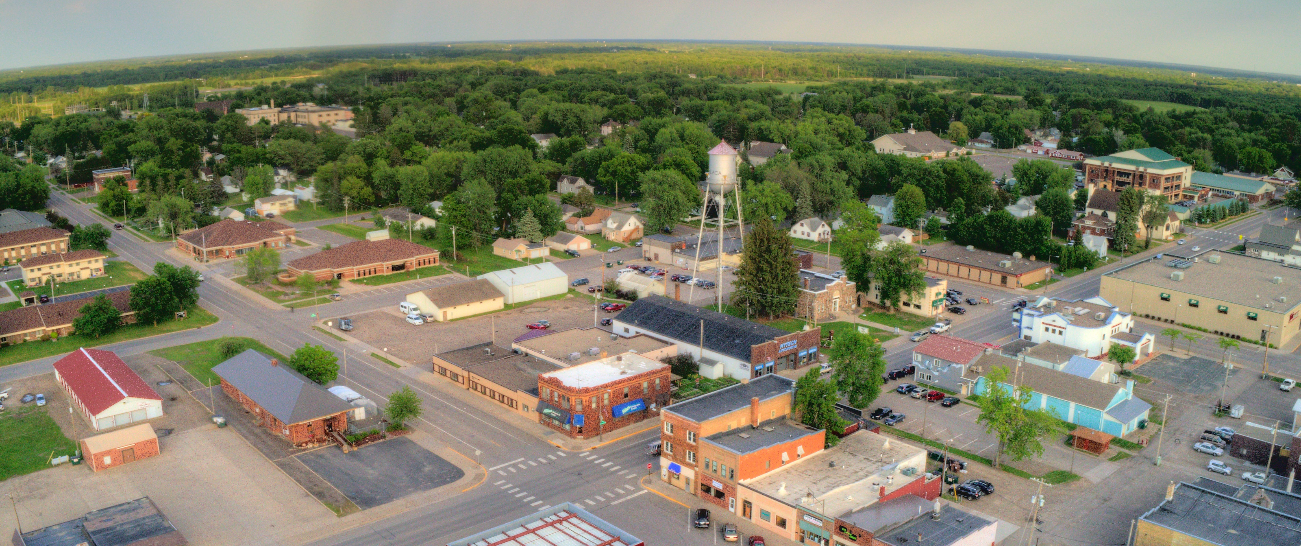
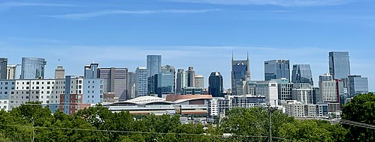
Creating Microclimates
Learning objectives
Small-scale climate variations
Factors that create microclimates
How do microclimates affect humans?
How are microclimates affected by climate change?
Air Mixing
Less air mixing with densely packed buildings
COOL
COOL
vs
WARM
MODERATE
WARM
WARM
WARMER
Notes:
*NOTE: slides are animated to walk through each scenario*
Air mixing is an important factor in keeping the surface cooler. If you have cool air higher in the atmosphere and warmer air at the surface, wind can mix the air and create a more moderate temperature like you are seeing with the small town here.
However, when we have buildings that are packed closely together, wind skims over the top and does not mix with surface air. This leaves surface air warm and holding trapped energy.
This also results in rural areas being able to cool off more effectively at night and urban areas retaining more heat at night.

Slide 8
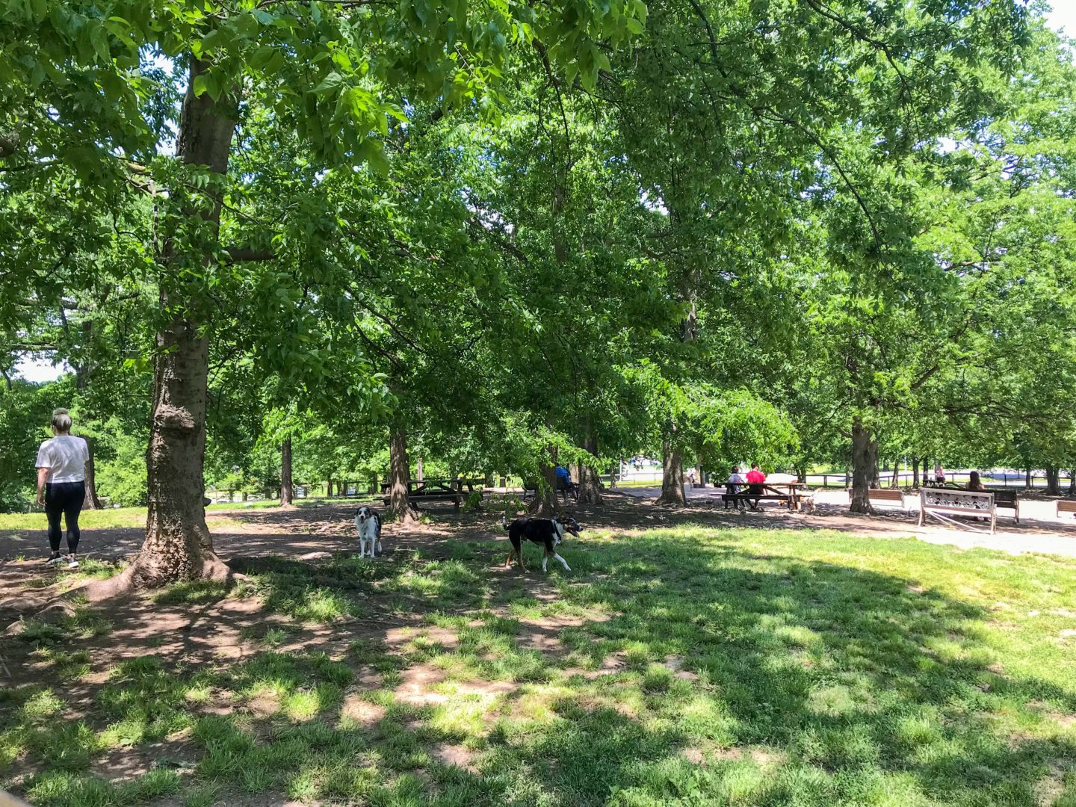
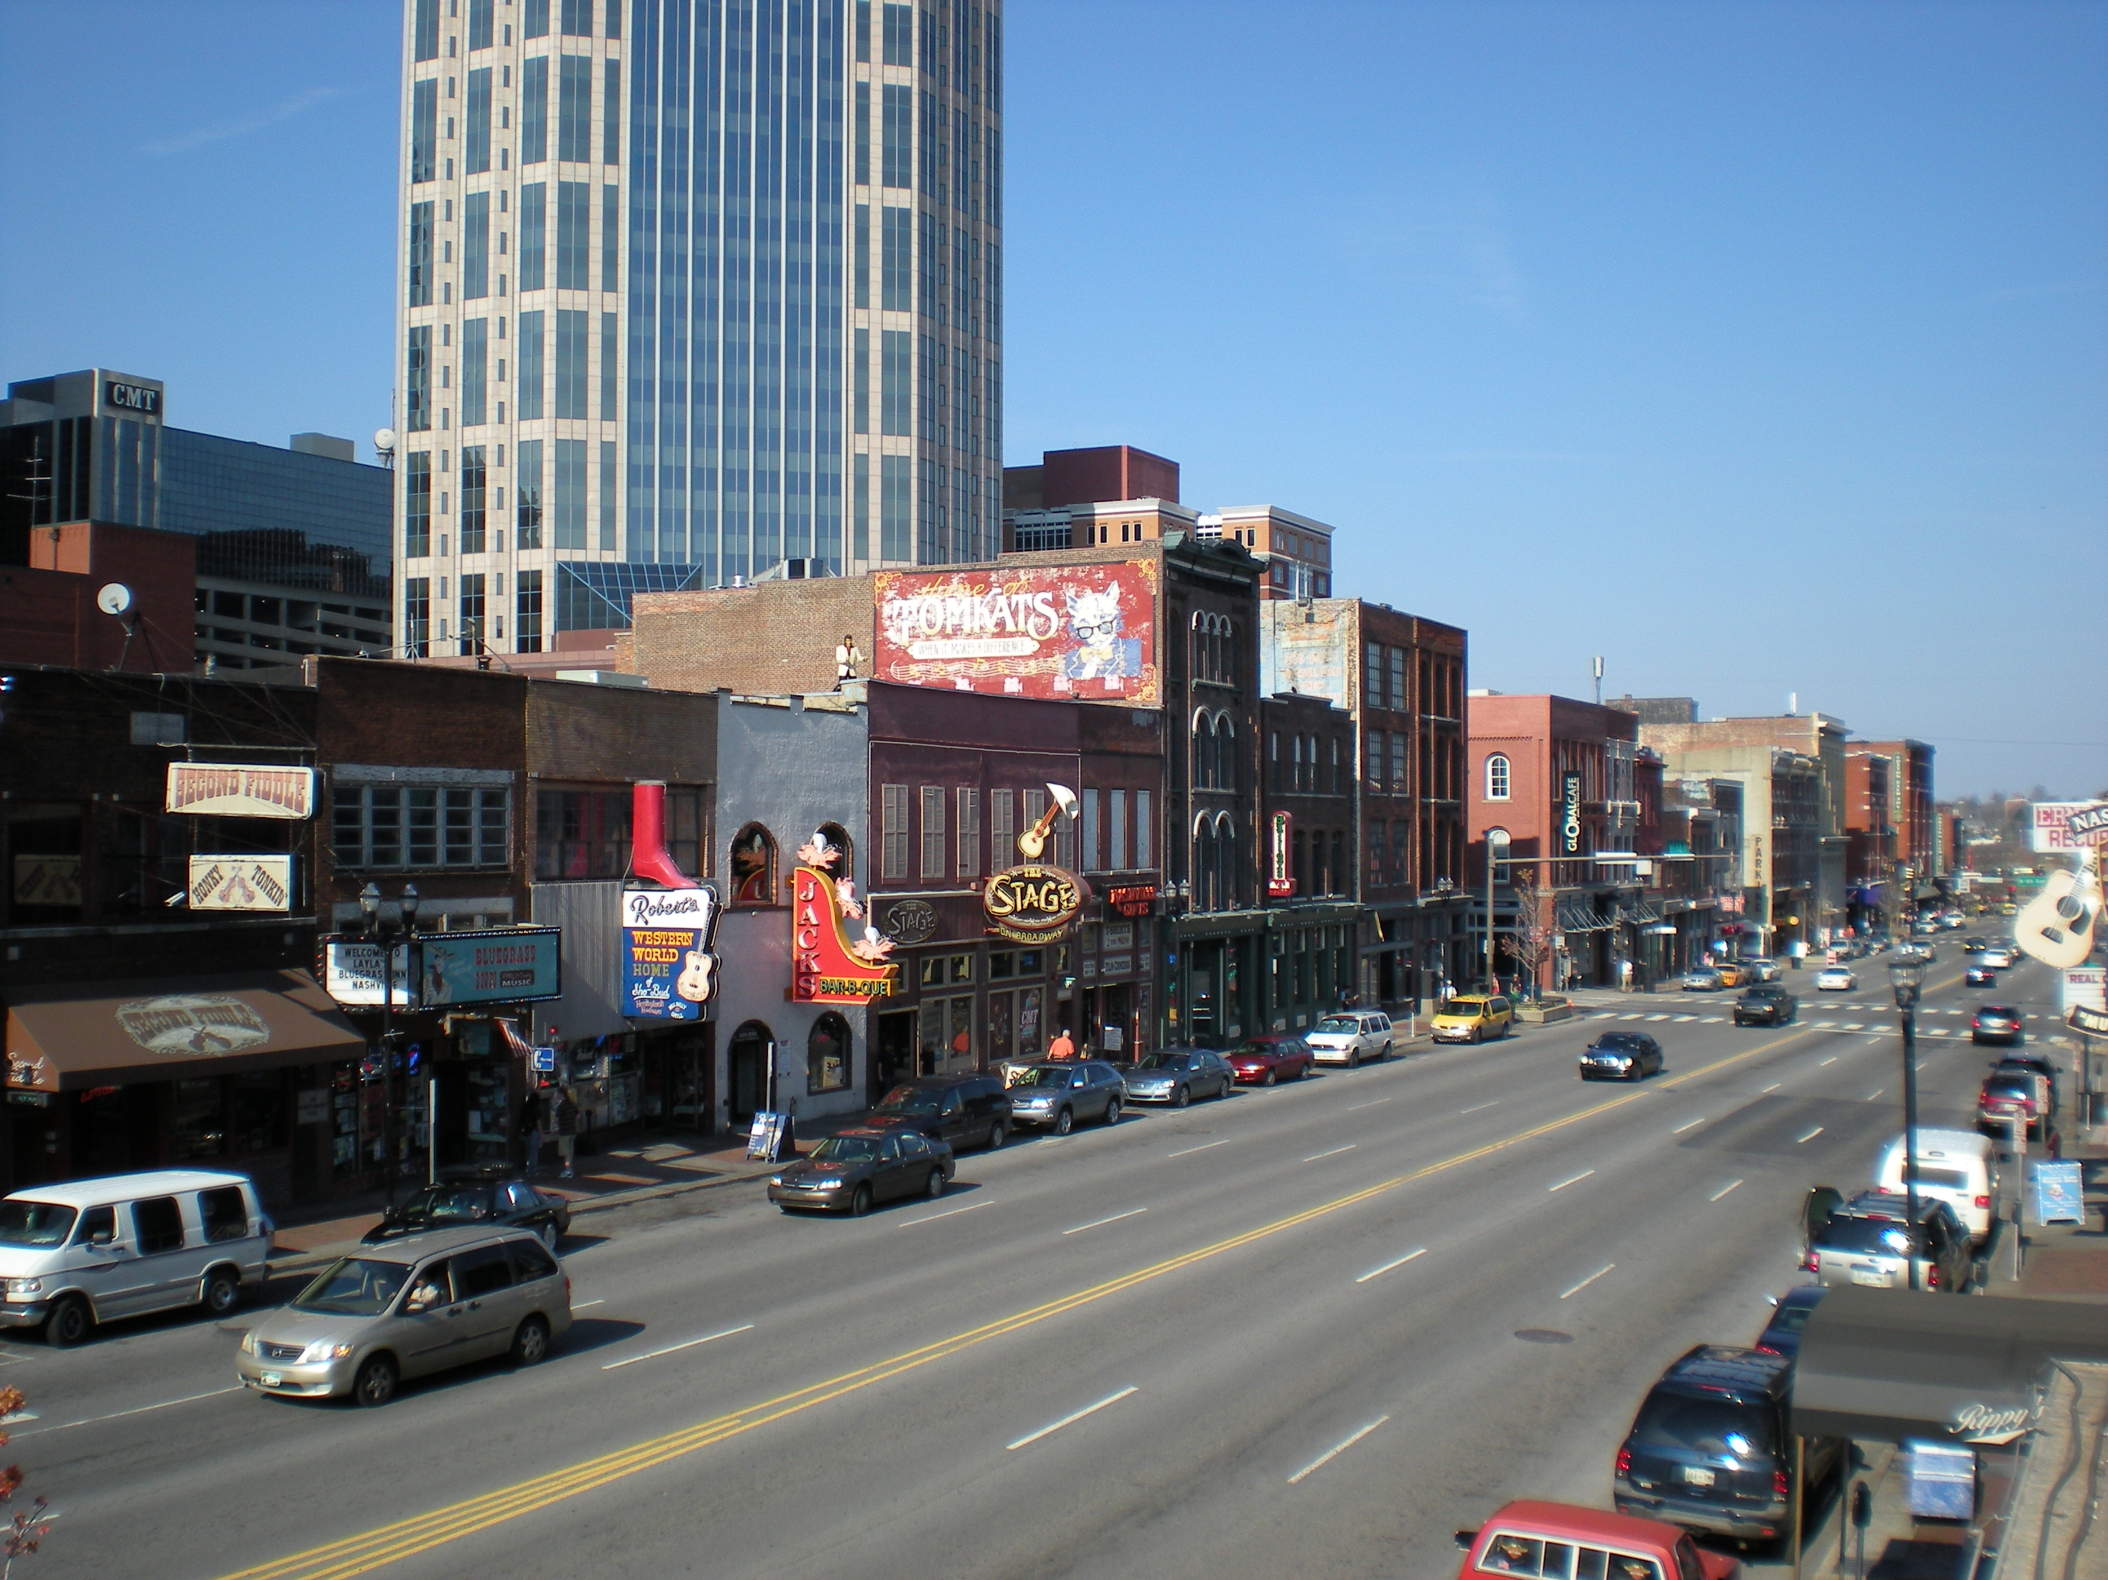

Creating Microclimates
Learning objectives
Small-scale climate variations
Factors that create microclimates
How do microclimates affect humans?
How are microclimates affected by climate change?
Landcover
Shading and high albedo provide cooling effect
Evaporative cooling from vegetation and waterways
Notes:
*raindrops and arrows animated to show evaporative cooling*
Tall buildings and canopy cover will provide shading and, thus block some of the insolation from reaching the surface. This will provide a cooling effect.
Likewise, waterways and vegetation will provide evaporative cooling. When vegetation respirates water into the atmosphere, that water evaporates, absorbing heat in the process and cooling the air around it. Waterbodies similarly cool the air by evaporating water off the surface.

Slide 9
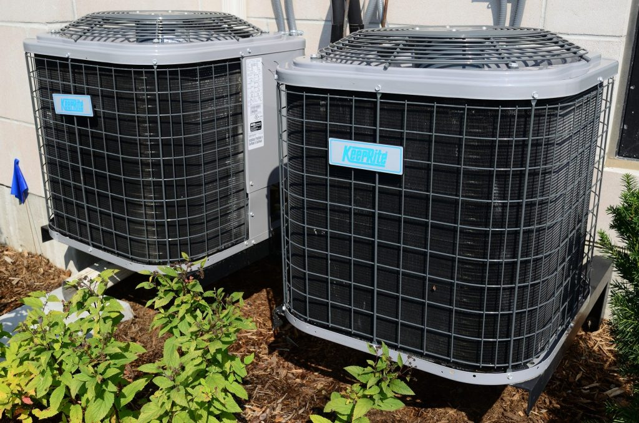
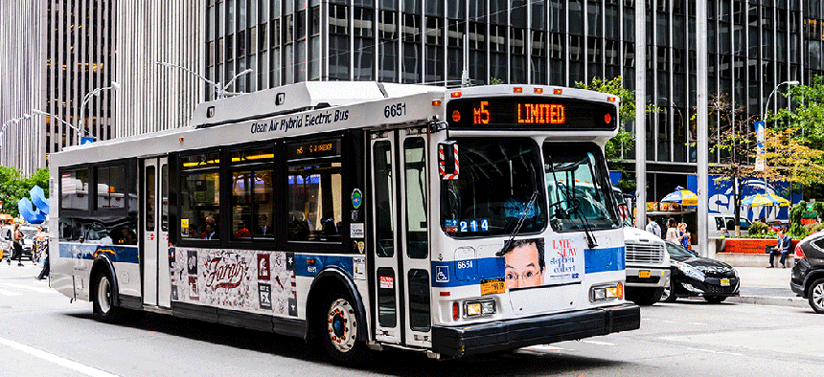
Creating Microclimates
Learning objectives
Small-scale climate variations
Factors that create microclimates
How do microclimates affect humans?
How are microclimates affected by climate change?
Anthropogenic Heat
We release heat when we drive cars, run air conditioners, and so on
Notes:
*arrows animated*
Consider a time that you’ve stood on the sidewalk and a bus drives past. You likely received a breeze of warm air – this is an example of anthropogenic heat.
Our everyday activities, such as driving cars and using air conditioners produce heat, which warms the air around it.

Slide 10
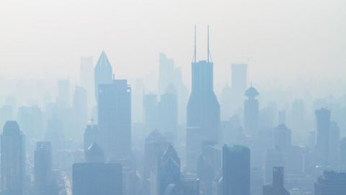
Creating Microclimates
Learning objectives
Small-scale climate variations
Factors that create microclimates
How do microclimates affect humans?
How are microclimates affected by climate change?
Air pollution
Less air mixing keeps pollutants near surface
Absorbs heat and traps it near the surface
Notes:
Air pollution cannot be as easily dispersed as winds are disrupted and not mixing the air with fresh air aloft.
With this, pollutants absorb heat and help trap it near the surface.

Slide 11


Creating Microclimates
Learning objectives
Small-scale climate variations
Factors that create microclimates
How do microclimates affect humans?
How are microclimates affected by climate change?
The effects of these factors are on a sliding scale!
Vegetation only
Concrete & buildings
Notes:
Air pollution cannot be as easily dispersed as winds are disrupted and not mixing the air with fresh air aloft.
With this, pollutants absorb heat and help trap it near the surface.

Slide 12
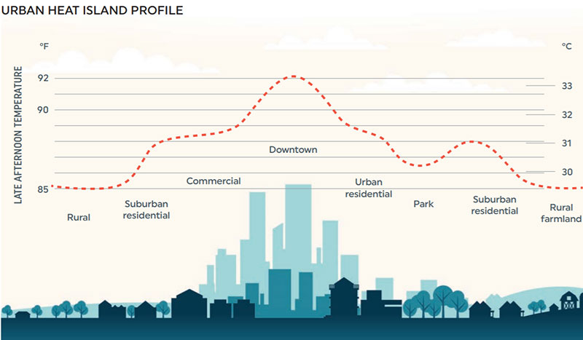
Creating Microclimates
Learning objectives
Small-scale climate variations
Factors that create microclimates
How do microclimates affect humans?
How are microclimates affected by climate change?
Image copyright Urban Land Magazine. https://urbanland.uli.org/wp-content/uploads/sites/5/2020/07/UHI-Profile-LBNL-Modified_800.jpg
Notes:
These factors result in what we call the urban heat island. This is where urban areas with a lot of concrete and compacted populations and buildings are warmer than rural areas. As you can see in this image, the downtown area has a late afternoon temperature of about 92°F. Surburbs and more residential areas have an afternoon temperature in the upper 80’sF. And very rural areas and farmland is closer to 85°F. However, even within urban and urban areas, we see variations in microclimates.

Slide 13
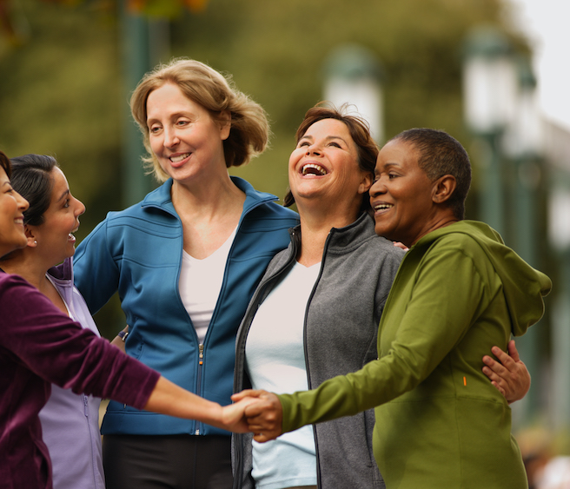
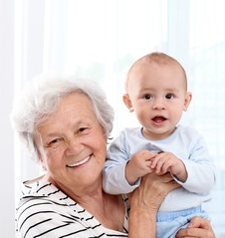
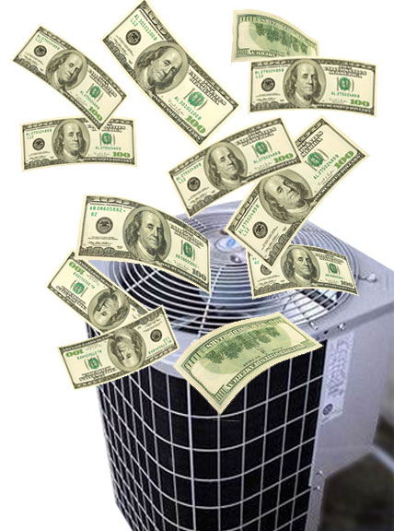
Microclimates and Humans
Learning objectives
Small-scale climate variations
Factors that create microclimates
How do microclimates affect humans?
How are microclimates affected by climate change?
Vulnerability to heat exposure and heat-related illnesses varies by socioeconomics and demographics
Social Support
Age- and Medical-Related Vulnerabilities
Income Disparities
Notes:
*Animated so each factor comes up one by one*
There are great disparities in vulnerability to heat exposure and heat-related health issues.
Those who have support of friends, family, and neighbors are at a lower vulnerability to the effects of heat as they have someone to rely on if their heat protection (e.g., air conditioning) is unavailable.
Some people, such as the elderly, young children, those on certain medications, and those with some medical conditions are more at risk for heat-related illnesses as they have a reduced ability to regulate their body temperature and/or have medical conditions that can be exacerbated by heat.
Income also plays a role in a person’s ability to weather heat in warm microclimates. Air conditioning is expensive to run and, in some locations, air conditioners may be inefficient or unavailable. Likewise, many low-income neighborhoods are located within the inner parts of the city where the heat island is most intense.

Slide 14
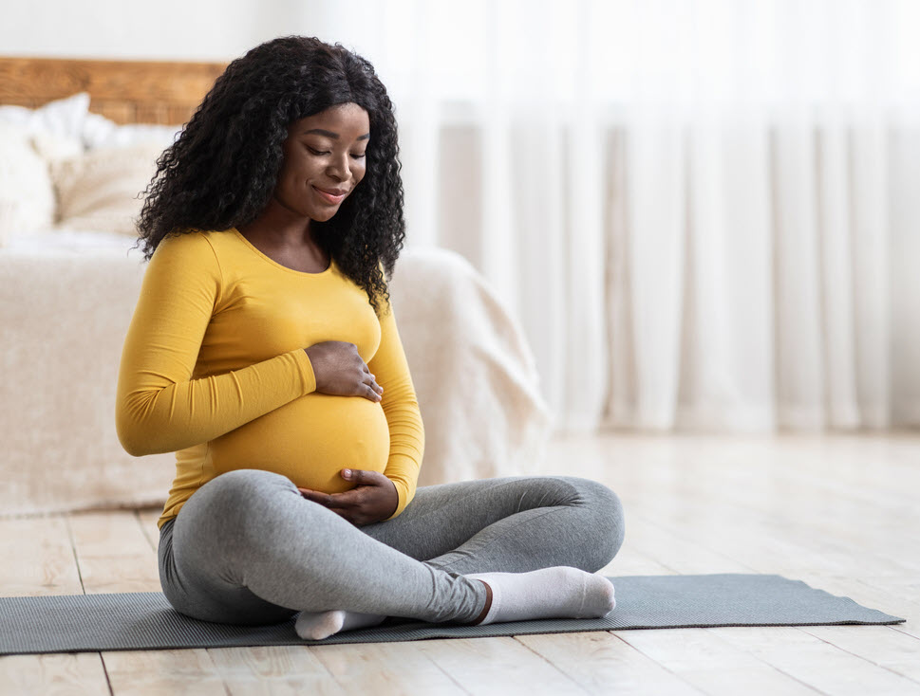

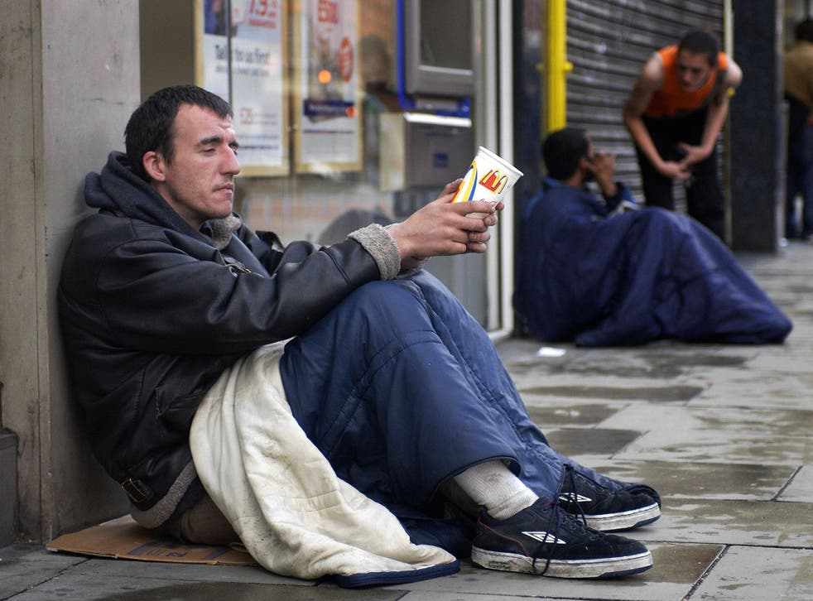
Microclimates and Humans
Learning objectives
Small-scale climate variations
Factors that create microclimates
How do microclimates affect humans?
How are microclimates affected by climate change?
Vulnerability to heat exposure and heat-related illnesses varies by socioeconomics and demographics
Pregnancy
Unhoused Populations
Education
Notes:
*Animated so each factor comes up one by one*
Other factors that affect vulnerability to heat is pregnancy – both for the mother and baby heat stress can be highly dangerous to health.
Unhoused populations are particularly vulnerable to heat as they do not always have access to reliable cool facilities and are often located in high concrete and urban heat intensity areas.
Finally, education plays a major role in heat vulnerability. This is because those who are more education are more likely to have been informed on how to care for themselves during different weather events and they are well versed in obtaining information to keep them safe, such as finding heat warnings and cooling shelters.

Slide 15
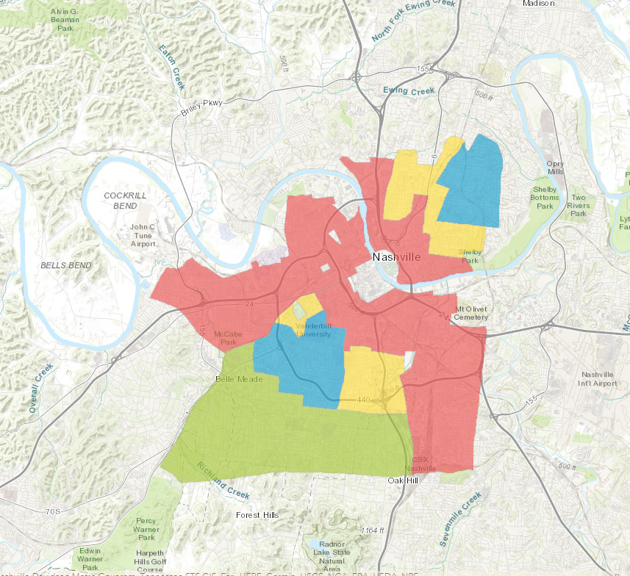
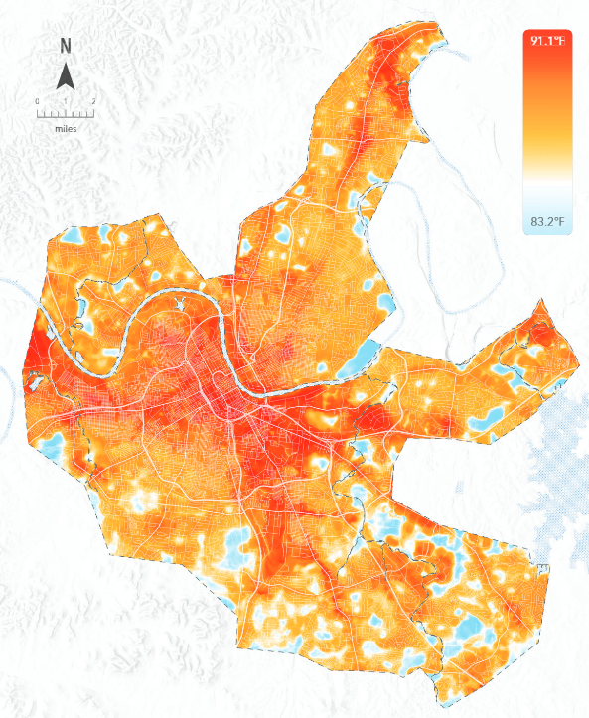
Microclimates and Humans
Vulnerability varies by history
Learning objectives
Small-scale climate variations
Factors that create microclimates
How do microclimates affect humans?
How are microclimates affected by climate change?
Green: “Best”
Blue: “Still desirable”
Yellow: “Definitely declining”
Red: “Hazardous”
Nashville: 7pm – 8pm
Historically redlined areas
Nelson et al. Mapping Inequality. https://dsl.richmond.edu/panorama/redlining/
Notes:
*Animated*
Vulnerability also varies by history.
Many larger cities, including Nashville as we are looking at here, experienced redlining from the 1930s to the 1960s. Redlining is a practice of reducing or eliminating investments, such as business loans and mortgages, in Black neighborhoods. These neighborhoods would literally be outlined in red as a “warning” to lenders. As you can see here, the red shaded locations are areas indicated as “hazardous” and yellow are areas indicated as “declining.” Both of these areas were highly minority and Black neighborhoods. Green areas were considered the best neighborhoods to invest in and were primarily white and upper class.
We can compare the redlining map to a 2022 heat mapping study from Nashville. Darker red colors indicate warmer temperatures and blue colors indicate cooler temperatures. Comparing historical redlined areas to today’s heat island intensity shows that there is still a match even 60 or more years later. These areas experienced disinvestments for many years and they have remained areas with more concrete, densely packed buildings, and less infrastructure improvements.

Slide 16
Microclimates and Climate Change
Learning objectives
Small-scale climate variations
Factors that create microclimates
How do microclimates affect humans?
How are microclimates affected by climate change?
Warm seasons becoming warmer, more heat events
Microclimates will either be a buffer to climate change or exacerbate warming in specific areas
Image copyright Urban Land Magazine. https://urbanland.uli.org/wp-content/uploads/sites/5/2020/07/UHI-Profile-LBNL-Modified_800.jpg
Notes:
So how might these microclimates be affected by climate change?
Current trends show that warm seasons are becoming warmer and we are experiencing more frequent, intense, and longer-lasting heat events.
Microclimates that have factors that keep the location cooler, such as open spaces and large amounts of vegetation, are going to be less affected by increasing heat.
Microclimates that have factors that keep the location warmer, such as a lot of concrete, packed people and buildings, a lot of roads, and less vegetation, are going to be more affected by increasing heat.
Thus, the heat island is likely to become more intense and those living in urban areas, especially those who are already vulnerable due to sociodemographics, neighborhood, and comorbidities, will feel heat stress more acutely than those living in rural areas.

Slide 17
How do climates vary within small spaces and how are these microclimates affected by climate change?
Learning objectives
Small-scale climate variations
Factors that create microclimates
How do microclimates affect humans?
How are microclimates affected by climate change?
Microclimates are created from varying amounts of:
Concrete
Densely packed buildings
Air mixing
Vegetation
Anthropogenic heat
Rural areas tend to be cooler than urban areas
Vulnerability varies by socioeconomics, demographics, age, health, and social connections
Areas with factors that exacerbate the urban heat island are more likely to feel heat stress as global temperatures increase

Slide 18
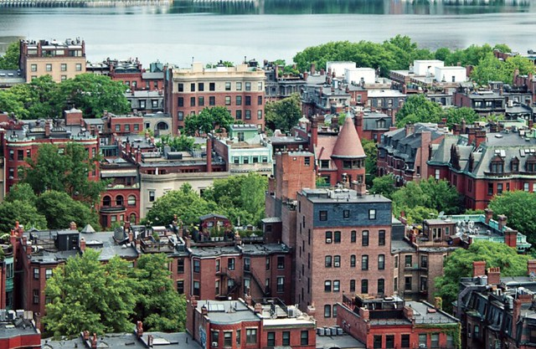
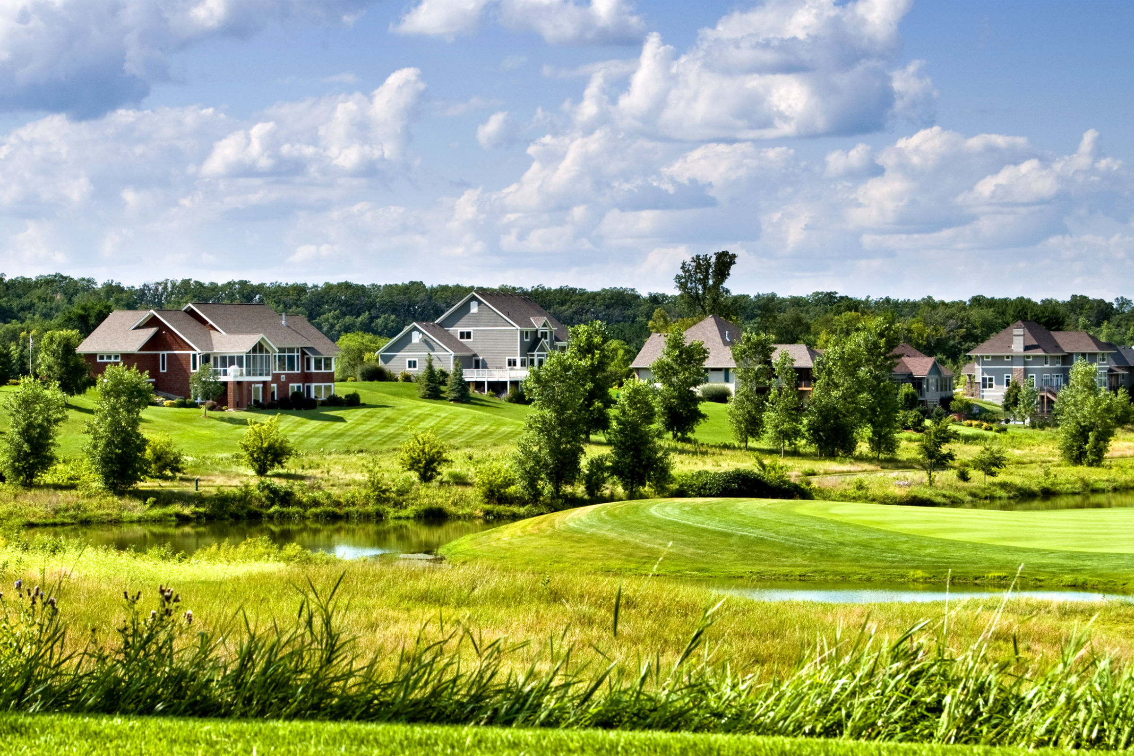
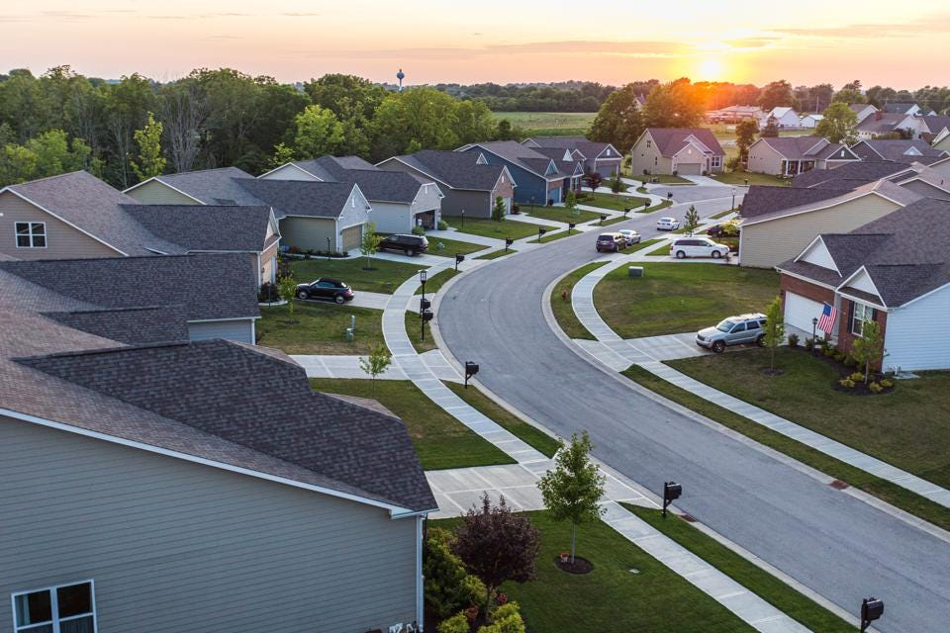
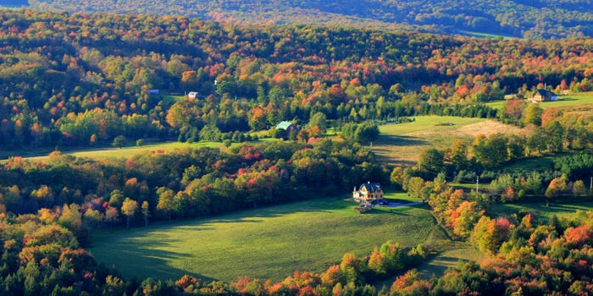
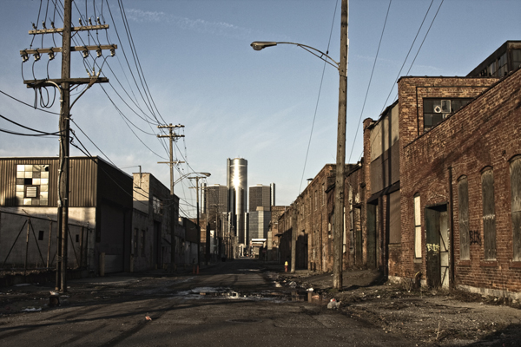
Activity: Rank the images from coolest (1) to warmest (5)
A
B
C
D
E
Notes:
Coolest (1): D
2: B
3: C
4: A
Warmest (5): E

Slide 19
Discussion Prompts
How would each of the following scenarios affect how warm a microclimate in an urban area will be?
Greenspaces being converted asphalt parking lots.
More tall buildings are built.
More air conditioners and motor vehicles operate.
How and why does vulnerability to heat exposure and illness differ between people?
What is the connection between redlining and urban heat?
Will climate likely change more in a rural microclimate or an urban one? Explain.

